Slide 1

Society of Physics Students
Intro to Python
October 13th 12:00PM

Slide 2
Society of Physics Students
Intro to Python
October 27th 12:00PM

Slide 3
Society of Physics Students
Intro to Python
October 20th 12:00PM

Slide 4
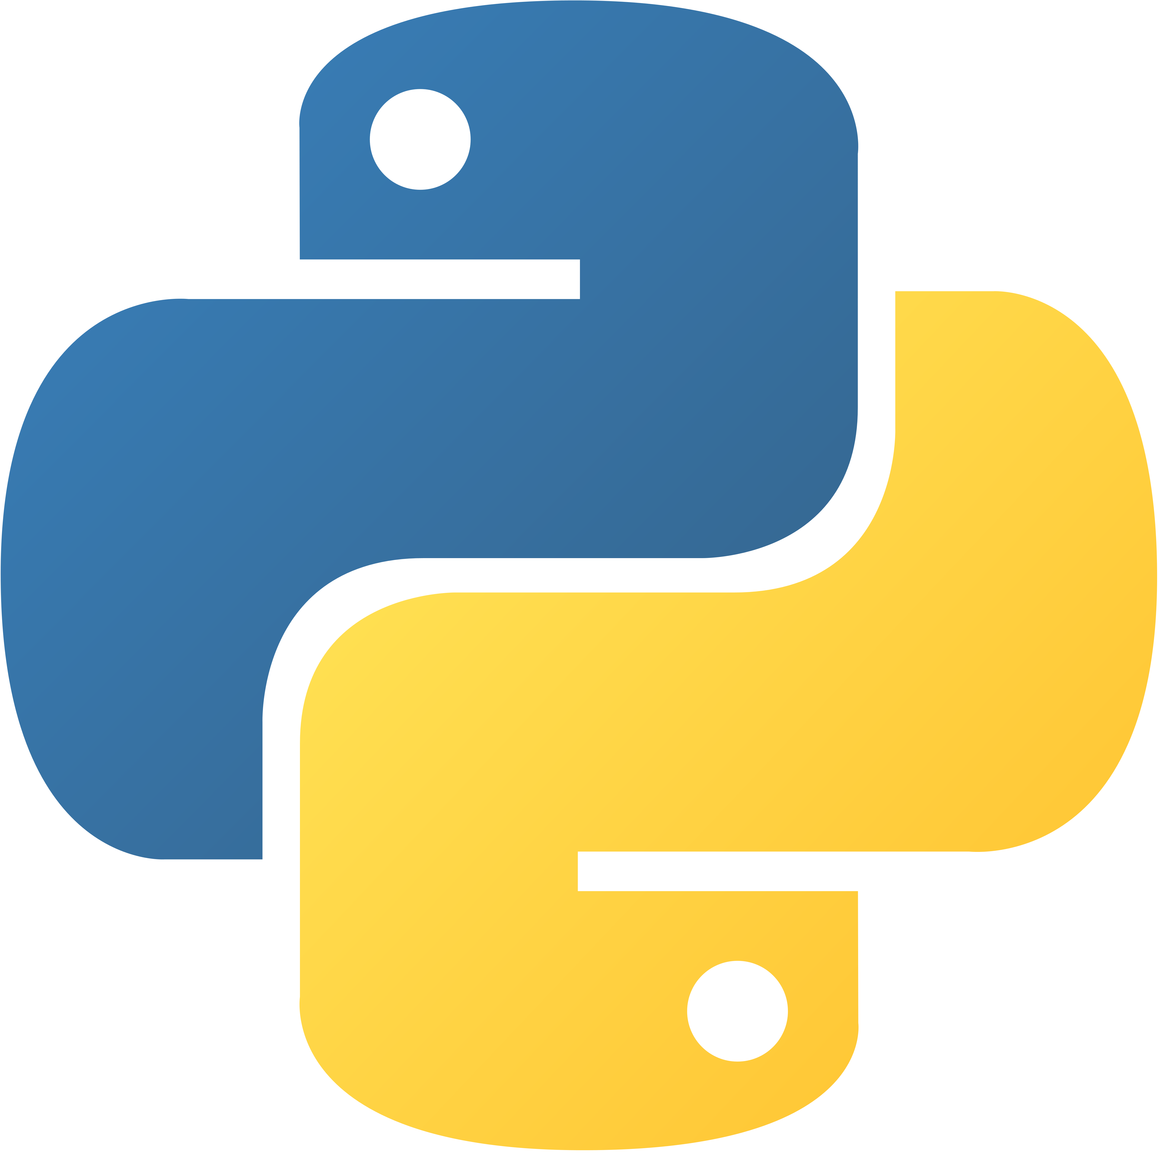
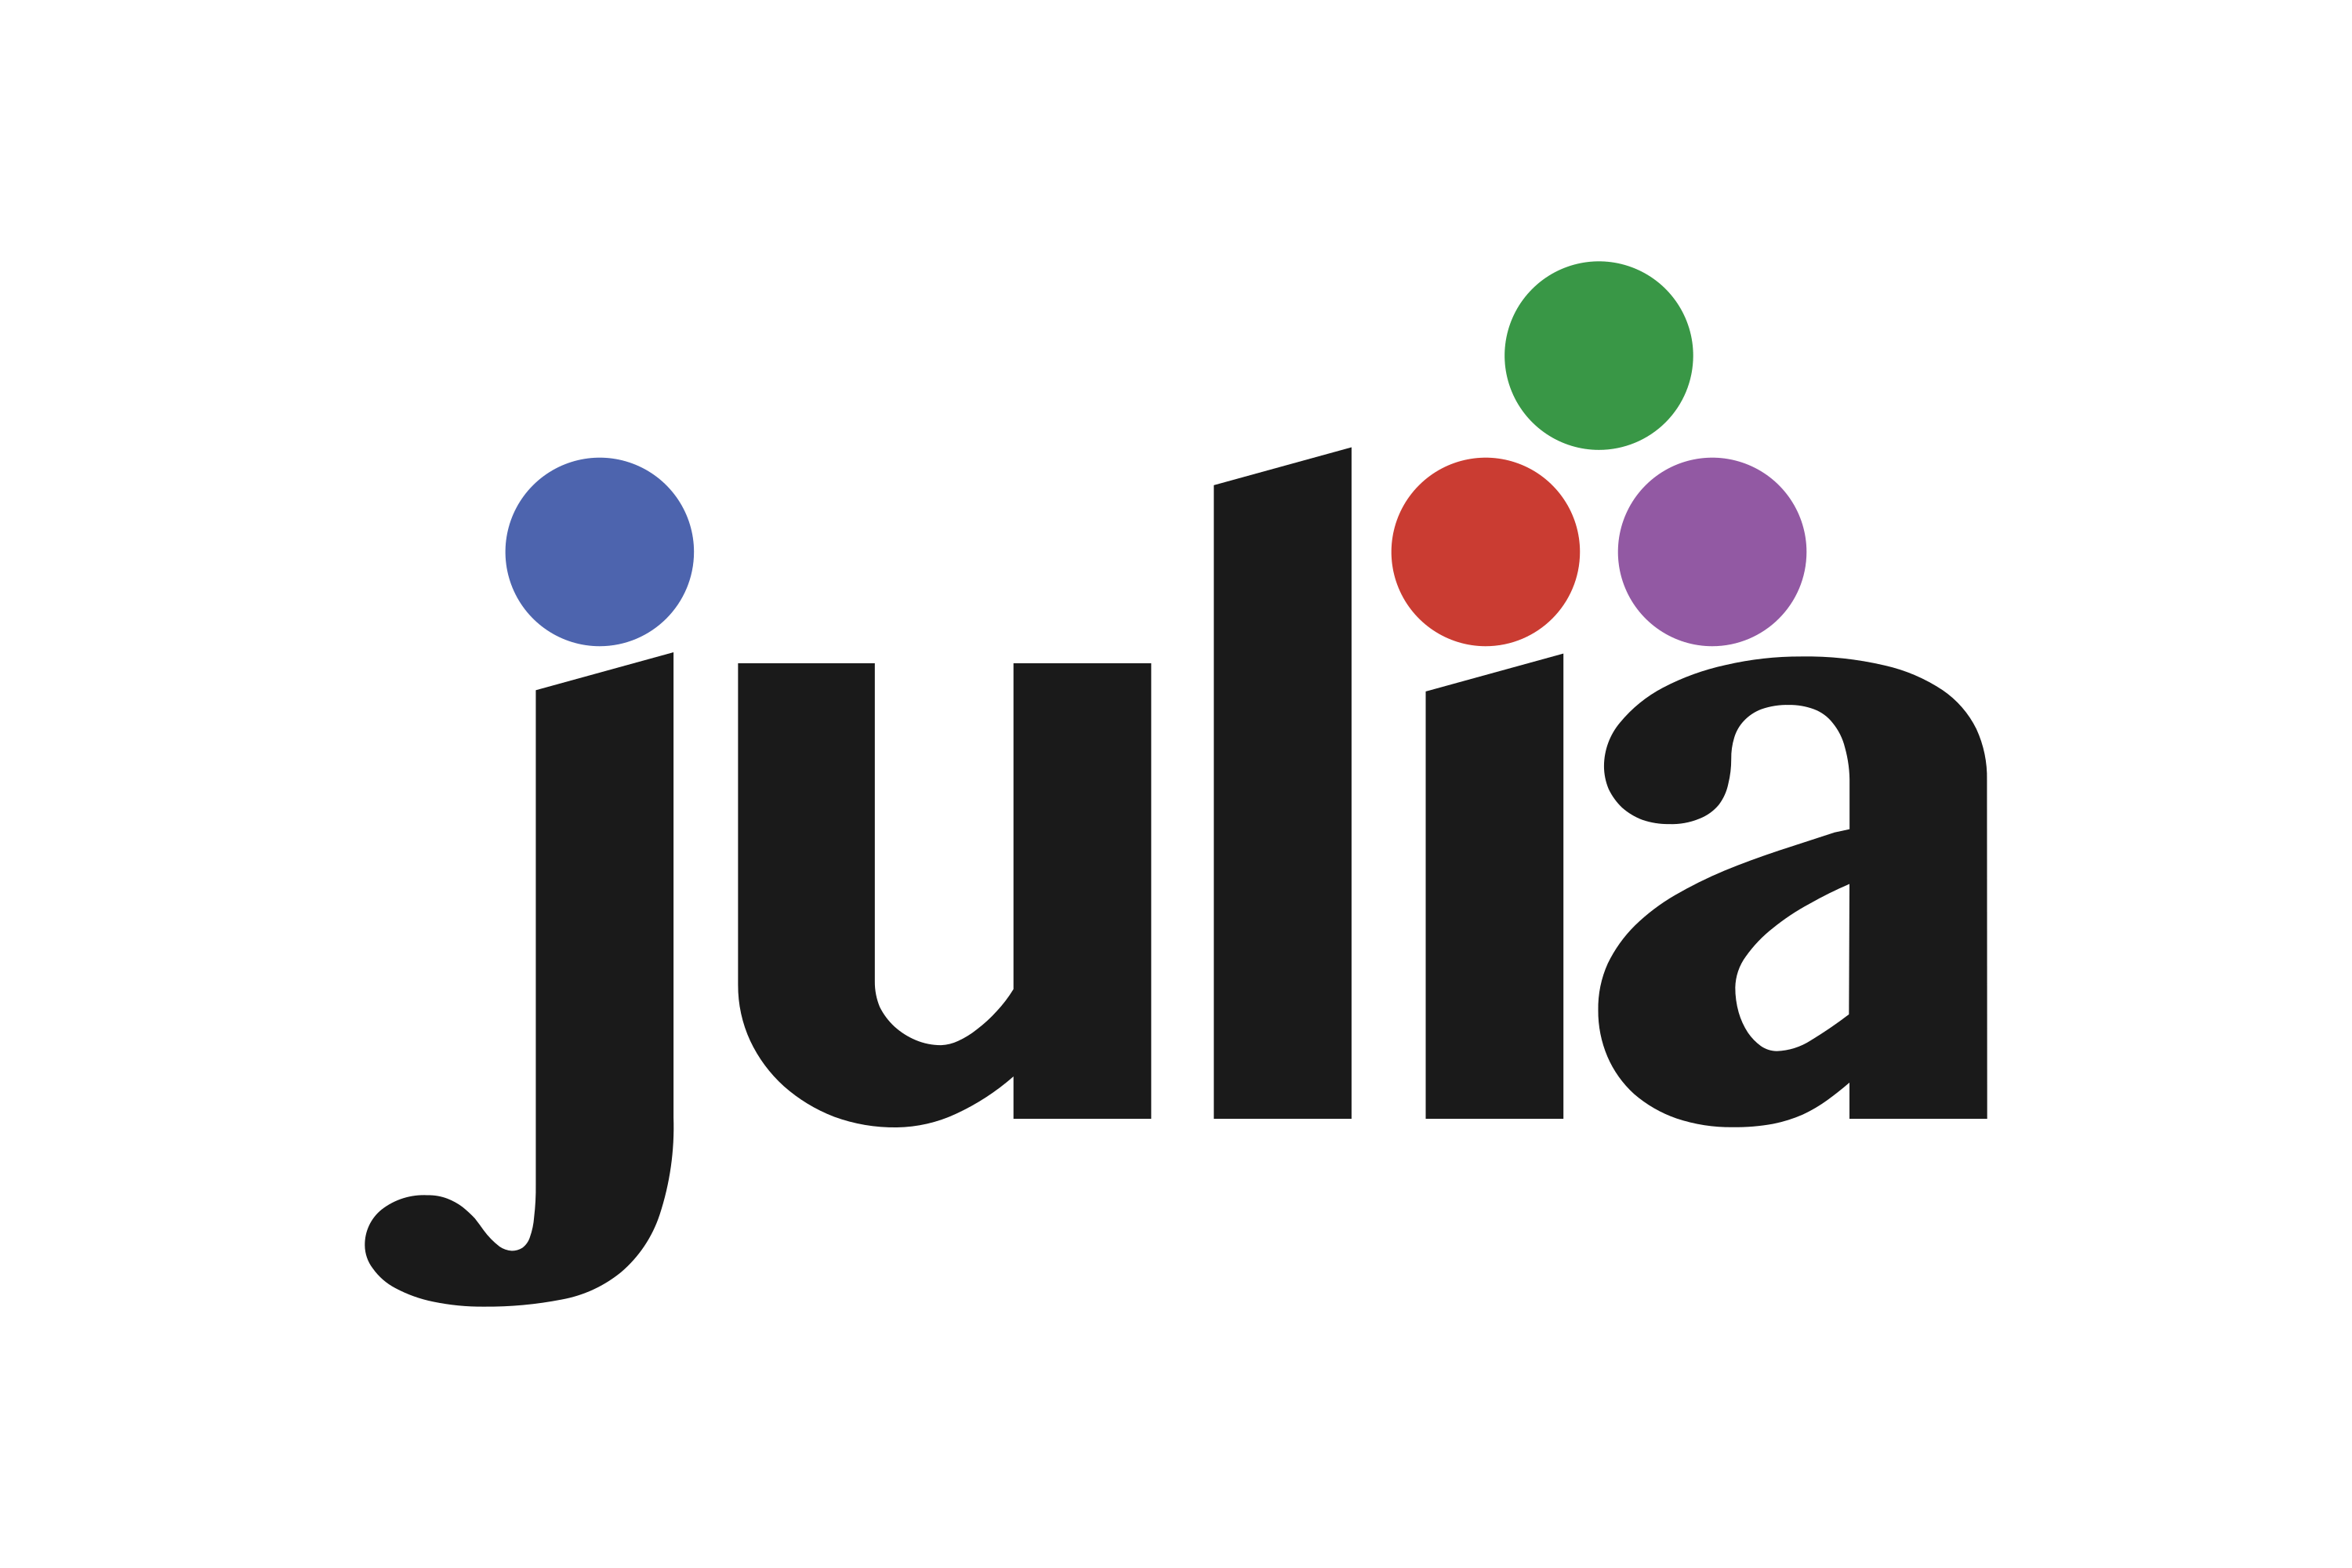



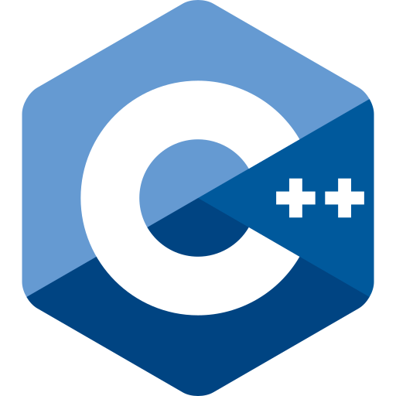
Why Coding as a Physicist is Important?

Slide 5
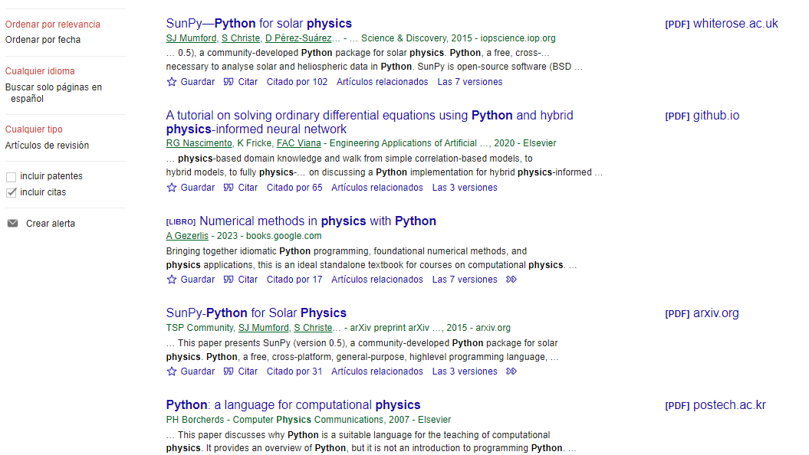

Slide 6
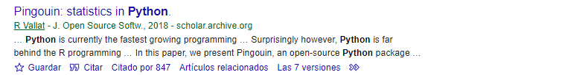
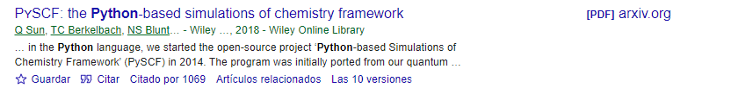
To which we can list of a series of famous physics simulation and montecarlo softwares
https://en.wikipedia.org/wiki/Geant4
https://en.wikipedia.org/wiki/DelPhi
https://en.wikipedia.org/wiki/ROOT
https://en.wikipedia.org/wiki/WIEN2k

Slide 7
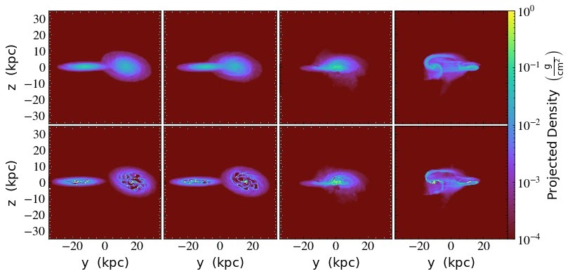
Gadget4 Simulation (Implemented in C++) And Data Analysis with (Python and Project yt library)

Slide 8
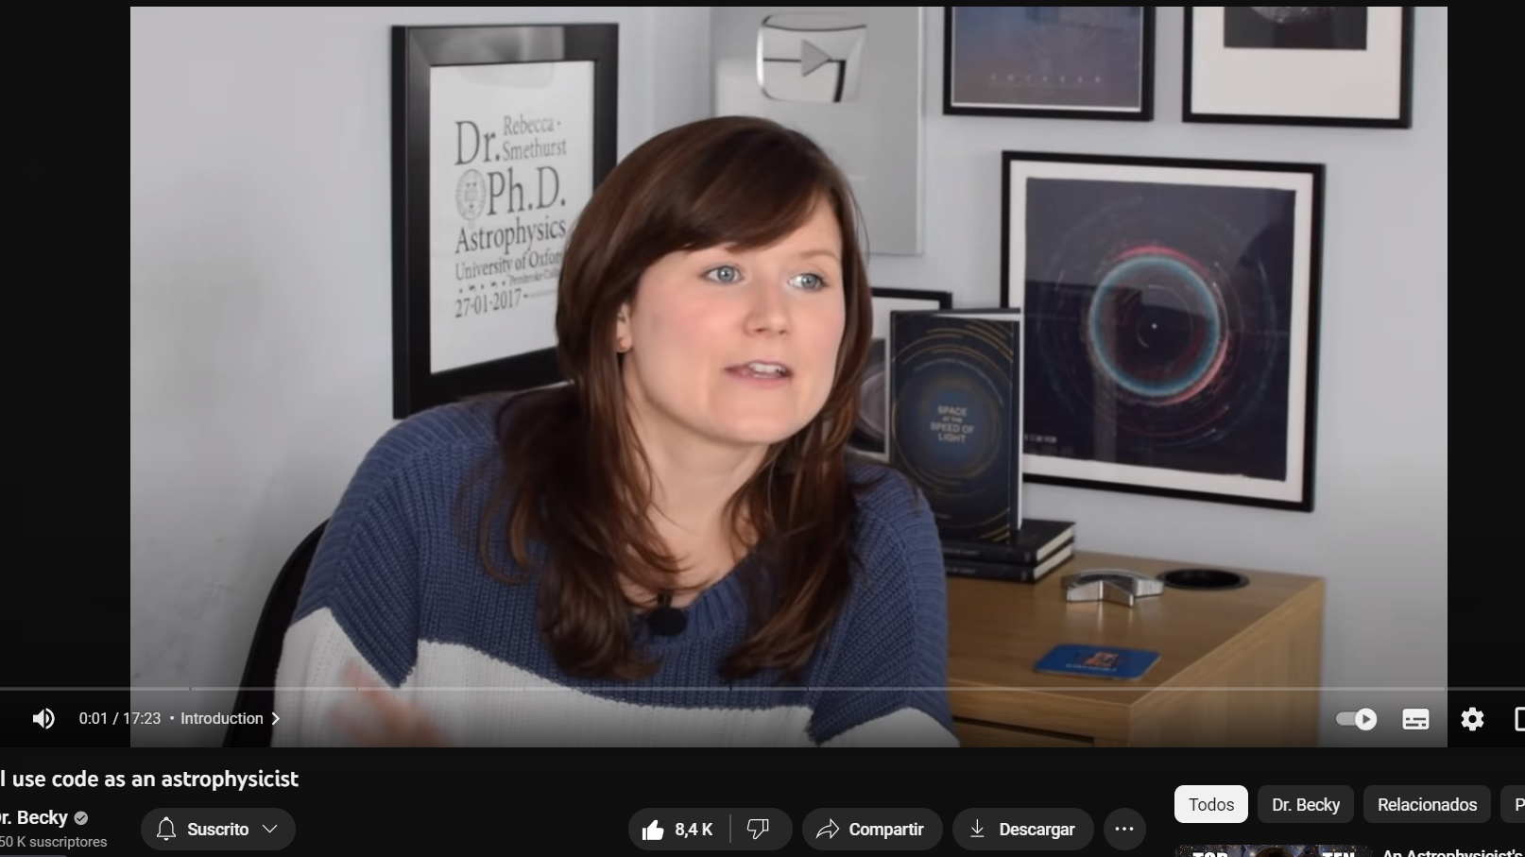
This is a video that we recommend you guys can see in you spare time
Astrophysicist&Coding

Slide 9



Who are we?
Aldo Sanchez
Computer Science Senior
Google ML Intern – Python
Microsoft Intern
MCA Foundation Intern
Tadeo De La Rocha
Computer Science Junior
Software Engineer Intern Google (x2)
Byron Encinas Velazquez
Physics Graduate
Scholarship with Conacyt for the development of materials fracture simulations
National Physics Congress, Star Formation Data Analysis with Gadget-4

Slide 10
With no further ado...
Let's get started with Python!

Slide 11
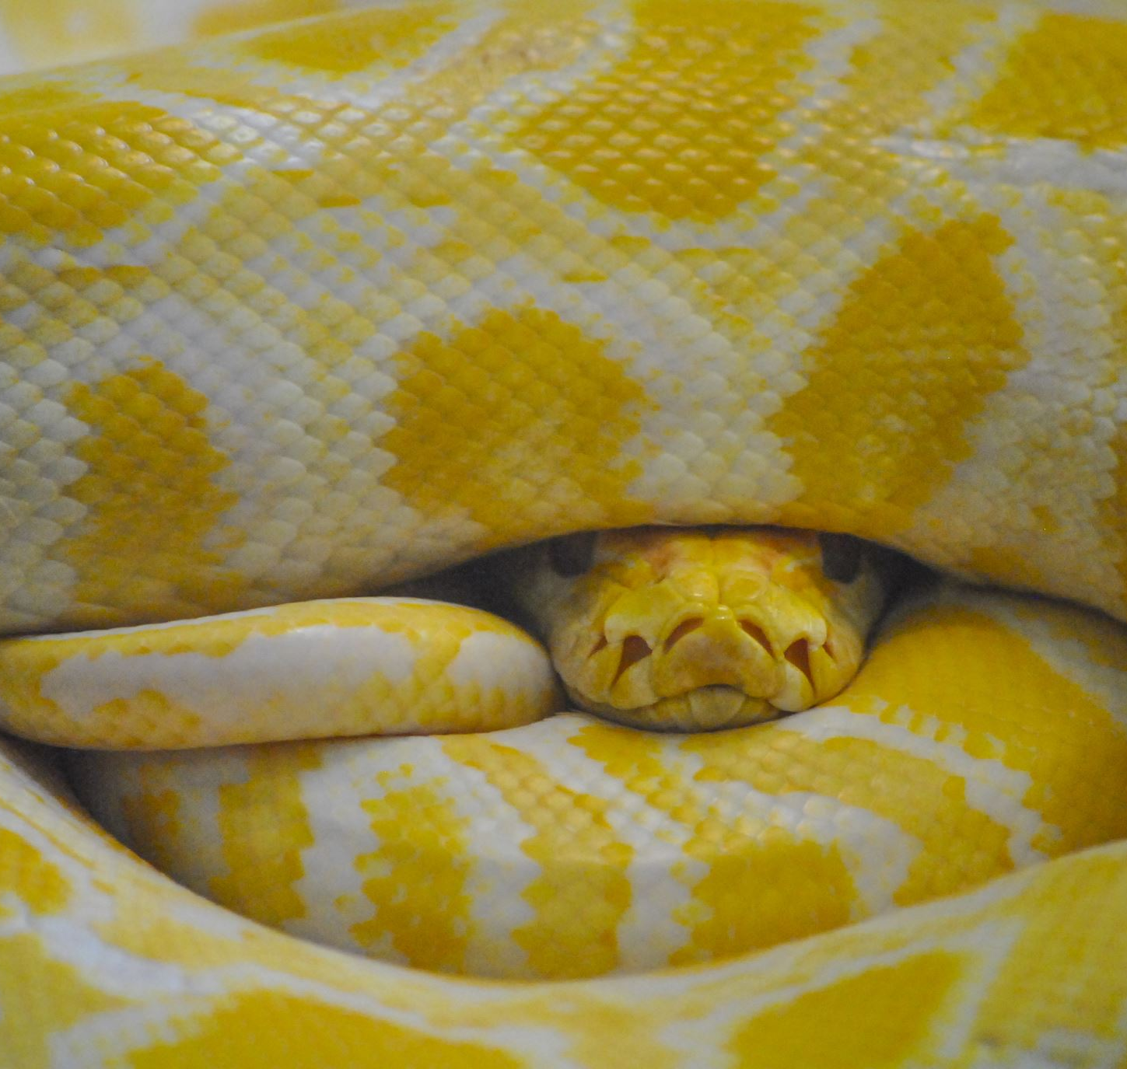
Outline
Introduction
Setting up Python
Variables and Data types
Arithmetic operations
Conditionals
Loops
Functions

Slide 12

Intro to Python Workshop
In this workshop, we'll introduce you to Python, a powerful programming language that is widely used in physics and various other fields.
Our goal is to equip you with the foundational Python skills you need for your physics studies.

Slide 13

What is Python?
Python is a high-level programming language.
It's known for its versatility and is used in various scientific and engineering disciplines, including physics.
Python is an excellent tool for data analysis, simulations, and automating repetitive tasks.
Lots of libraries including Numpy, Matplotlib, Simpy, etc.

Slide 14
Getting started with Python
Install Python: First, make sure you have Python installed on your computer. You can check if Python is already installed by opening a command prompt (on Windows) or a terminal (on macOS or Linux) and running the following command:
python --version
If not, you can download the latest Python installer for your operating system from the official Python website (https://www.python.org/downloads/).
Install a Code Editor: PyCharm: A Python-specific IDE developed by JetBrains.
Write Your First Python Program: Open PyCharm and create a new Python file with a .py extension.
In your Python file, write a simple "Hello, World!" program to get started:
print("Hello, World!")
Run Your Python Program: Save the Python file and then run it. To do this, open a terminal or command prompt, navigate to the directory where your Python file is located, and enter the following command:
python hello.py
You should see the output "Hello, World!" displayed in the terminal.

Slide 15
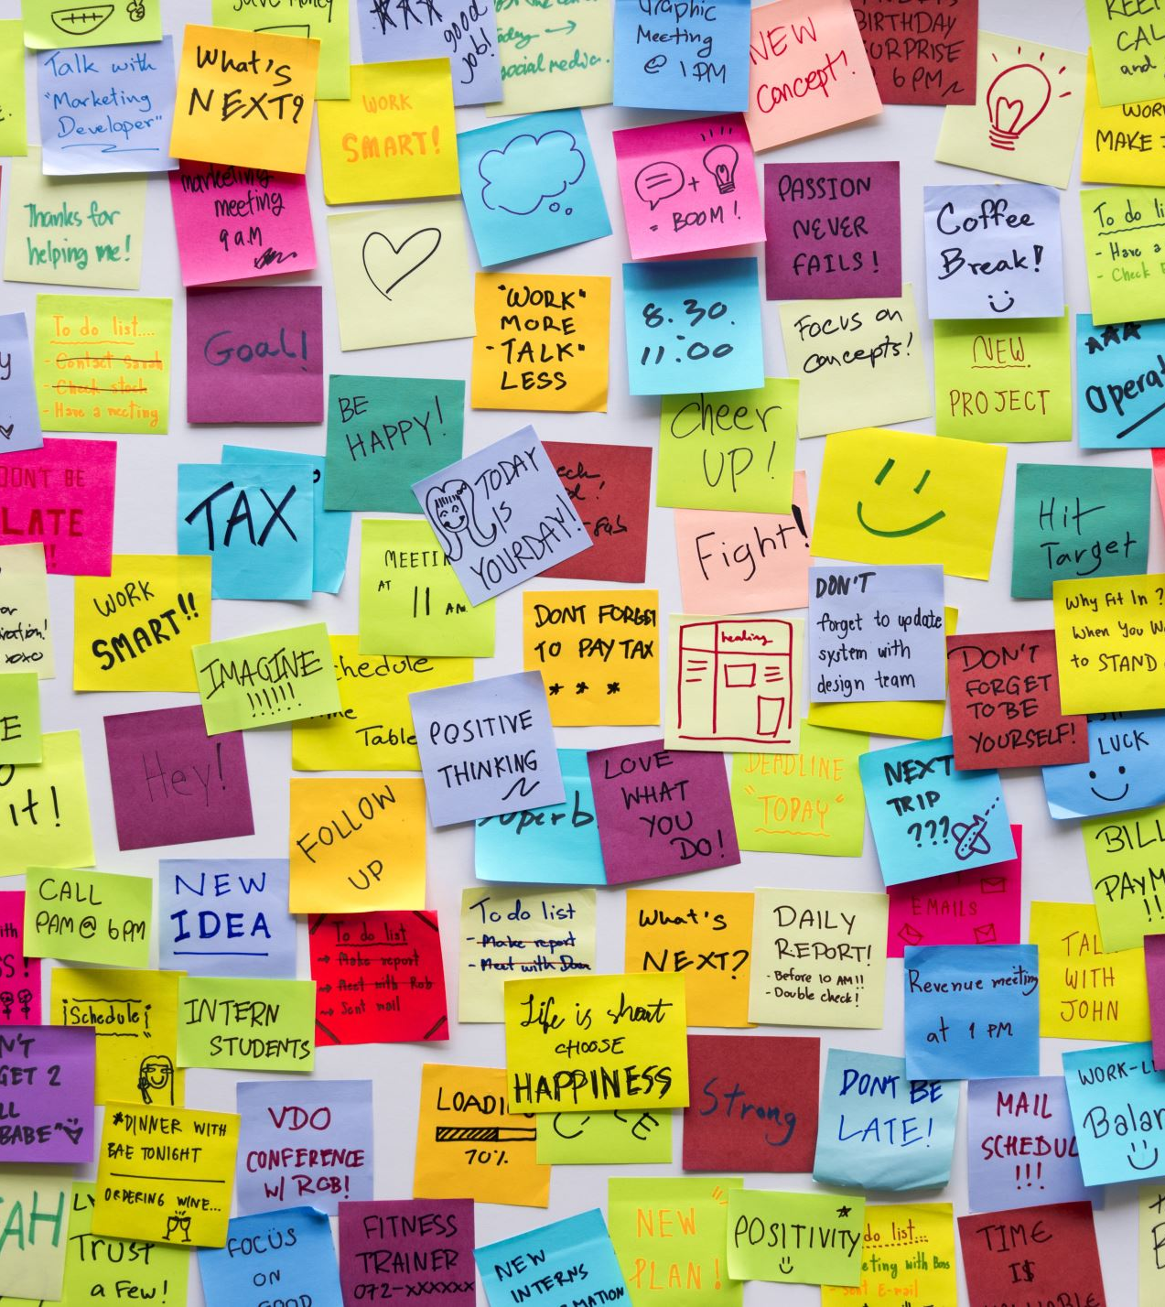
What are Variables?
Variables like containers that can store different types of data or values.
Think of variables as labeled boxes where you can put different things (data).

Slide 16

Python Variable Naming Rules:
Example_(GoogleColabNotebook)
Rules for naming variables in Python:
Variable names can only contain letters, numbers, and underscores.
Variable names must start with a letter or underscore but not a number.
Variable names are case-sensitive
Are myVar and myvar different variables?
Which of these examples are allowed as variable names:
Counter_1 index&3 Vector_12 first_force_x 2nd_force_y

Slide 17
Data Types in Python
Python has various data types to represent different kinds of data.
Most common data types:
Integers (int): Whole numbers like 5, -3, 0.
Floats (float): Decimal numbers like 3.14, -0.5, 2.0.
Strings (str): Text enclosed in single or double quotes, e.g., "Hello, World!" or 'Python'.
Booleans (bool): Represents True or False.

Slide 18
Data Type Examples
What data type should each of these be:
Cost of a flight
Name of a pet
Capacity of a classroom
Attendance of a person
Shoe size
Company stock value
Area of circle
Pi

Slide 19
Lists and indexing
myList = ["Hello", "this", "is", "a list"]
Lists are a collection of variables ordered numerically.
We can access the values inside a list by using brackets after the name of our list
"Hello" | "this" | "is" | "a list"
myList[0] | myList[1] | myList[2] | myList[3]

Slide 20
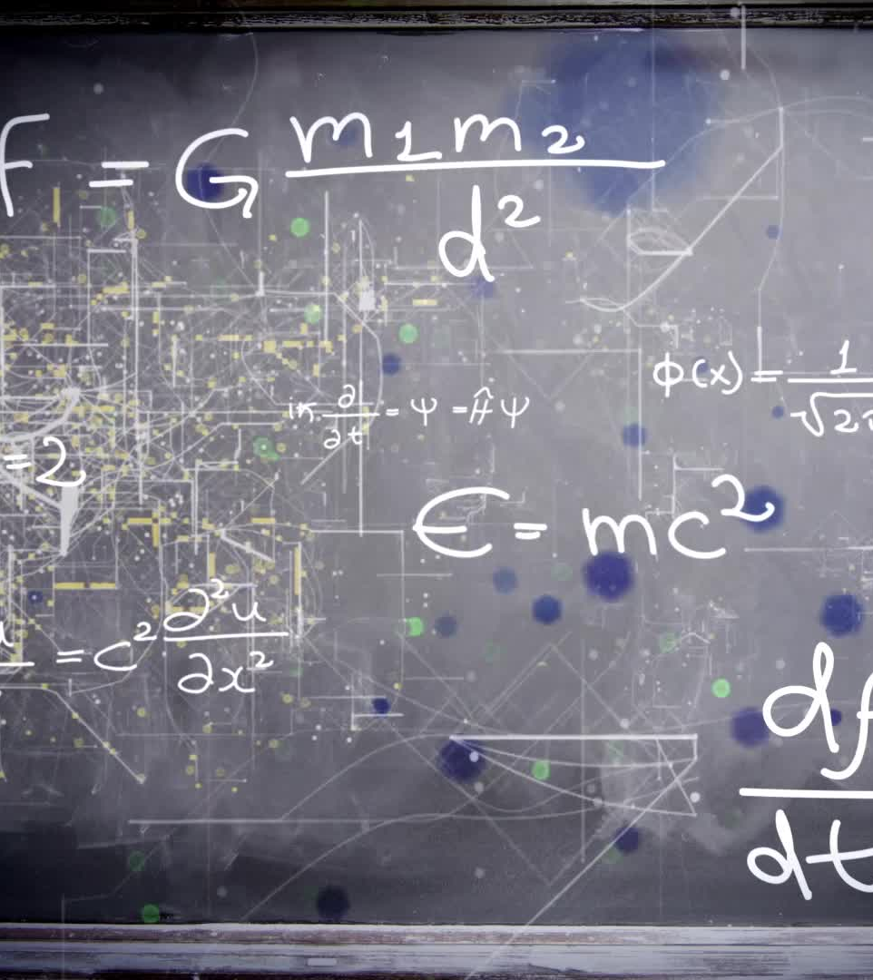
Variable Assignment:
Assign values to variables using the = operator.
x = 2
x = 5
print(x)
Variable assignments with different data types
x = 5 # Integer
y = 3.14 # Float
name = "John" # String
is_ready = True # Boolean

Slide 21

Using Variables:
How to use variables in simple expressions or print statements:
age = 25
increase = 3
updated_age = age + increase
print("I am", updated_age , "years old.")
age = 25
age = age + 3
print("I am", updated_age , "years old.")

Slide 22

Data Type Conversion:
Python allows you to convert between data types if needed.
num = 10
num_str = str(num) # Convert to string
num_float = float(num) # Convert to float

Slide 23
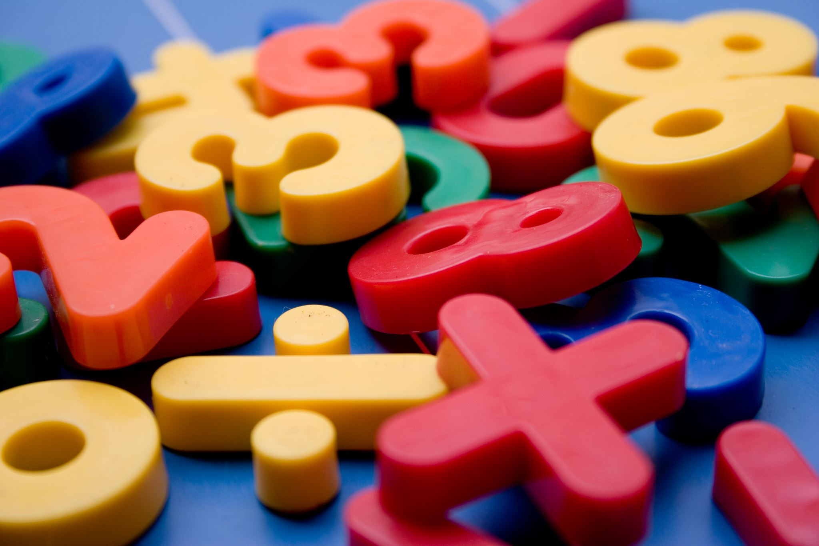
Arithmetic in Python
Addition (+): Use the + operator to add two numbers together.
Subtraction (-): Use the - operator to subtract one number from another.
Multiplication (*): Use the * operator to multiply two numbers.
Division (/): Use the / operator to divide one number by another.
(In Python 3, division returns a float by default.)
Modulo (%): Use the % operator to find the remainder when one number is divided by another.
num1 = 15
num2 = 7
remainder = num1 % num2
print("Modulo:", remainder) # Output: Modulo: 1
Using Parentheses for Order of Operations:
expression = (4 + 5) * 2
print("Expression with Parentheses:", expression) # Output: Expression with Parentheses: 18
Comments (lines that start with #) can help explain the purpose of your code and calculations code after # is not run

Slide 24
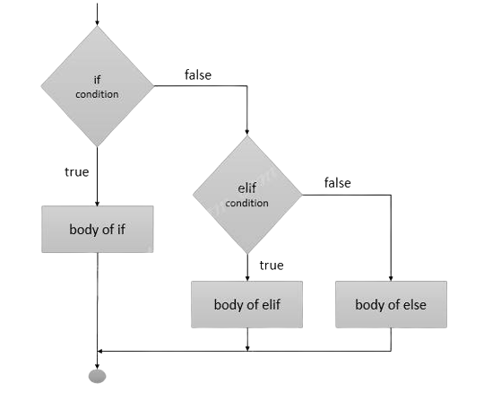
Conditionals
If Statements: Whenever we want to run a piece of code only if a certain condition is true we can use an if statement.
Else Statements: We can place an else statement after an if statement that will execute whenever our if condition fails.
Elif (else if) Statements: They are similar to else statements but they only execute if an additional condition is met.

Slide 25
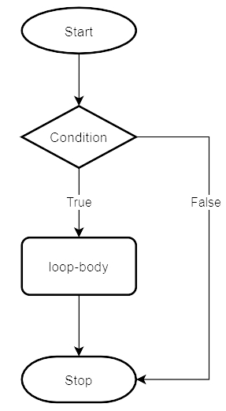
Loops
While loops: They will execute a specific block of code as long as the condition given is true.
For loops: They are used to repeat a specific block of code a known number of times.

Slide 26
Defining a function
Functions are blocks of code, this is useful as it allows us to run them as many times as we want without having to repeat the code over and over again.
Def addNumbers (int a, int b) {
c = a + b
Return c
}

Slide 27
Calling a Function
We can call a function by simply typing its name and passing it the parameters required, we can even assign the result to a variable if we know it will return something.
result = addNumbers (5, 6)

Slide 28
Taking input
We can take in user input by using the input function.
favoriteFruit = input("Type in your favorite fruit:")
The string we pass in will be printed before the user input is taken.

Slide 29

Working with Libraries
What libraries are most useful for a scientist?

Slide 30
Working with Libraries
What libraries are most useful for a scientist?
Numpy (numerical and mathematical manipulation of data)
Matplotlib (Data Visualization and Ploting)
Simpy (Symbolic Algebra)
Pandas (Database treatment)

